Slide 1
Artificial Intelligence & Machine Learning
TEXTBOOKS/LEARNING RESOURCES:
a) Masashi Sugiyama, Introduction to Statistical Machine Learning (1st ed.), Morgan Kaufmann, 2017. ISBN 978-0128021217.
b) T. M. Mitchell, Machine Learning (1st ed.), McGraw Hill, 2017. ISBN 978-1259096952.
REFERENCE BOOKS/LEARNING RESOURCES:
a) Richard Golden, Statistical Machine Learning A Unified Framework (1st ed.), unknown, 2020.

Slide 2
Decision Tree Classifier Example

Slide 3
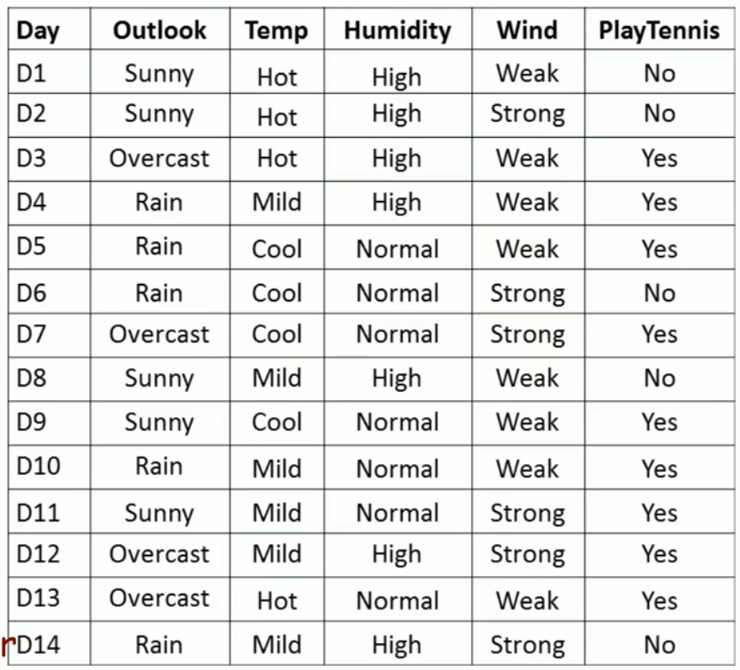
Dataset for Constructing a Decision Tree
Sample Space = 14
Attributes /Features = 4
Classes = 2

Slide 4
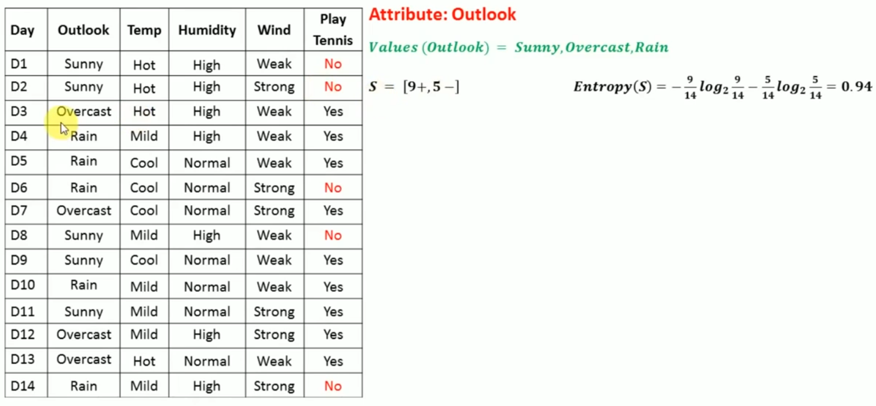

Slide 5
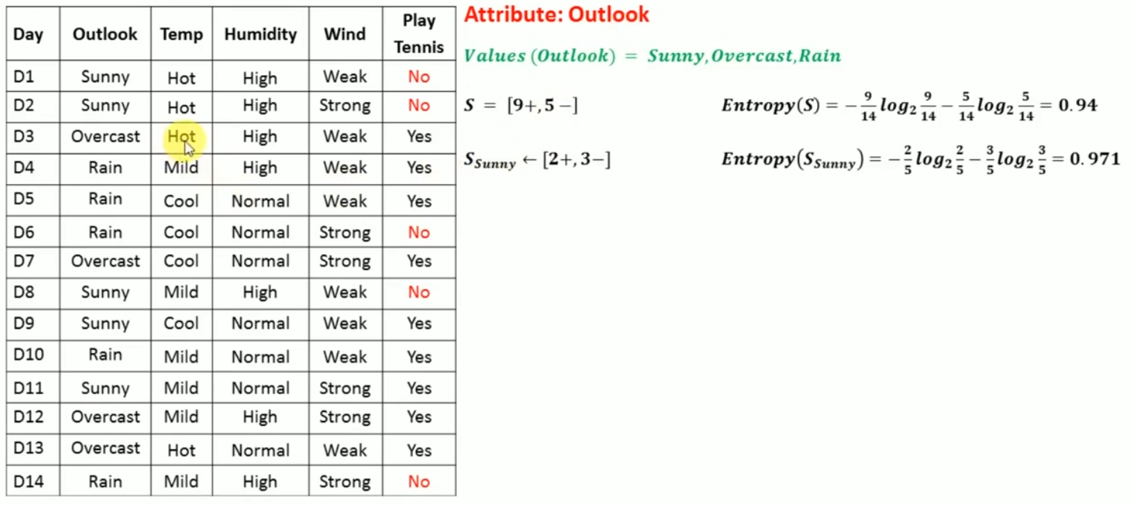

Slide 6
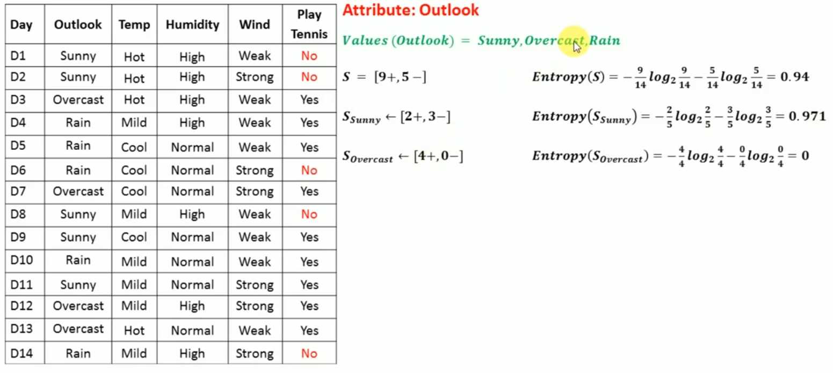

Slide 7
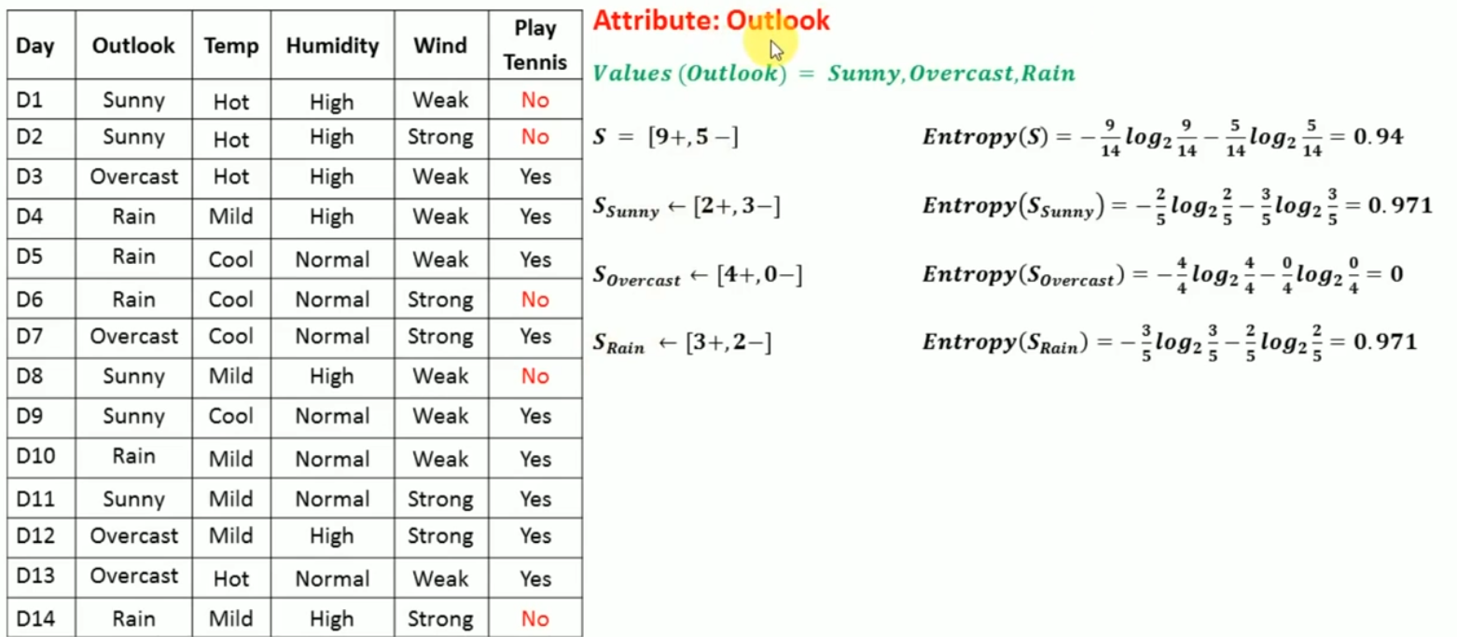

Slide 8
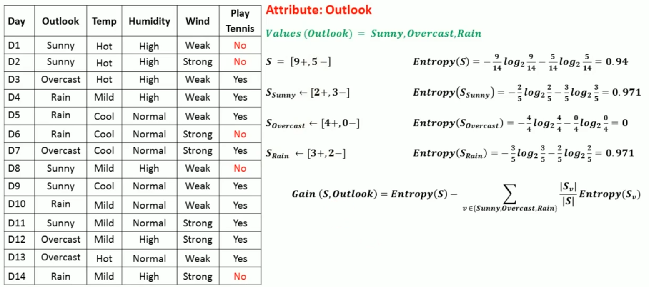

Slide 9
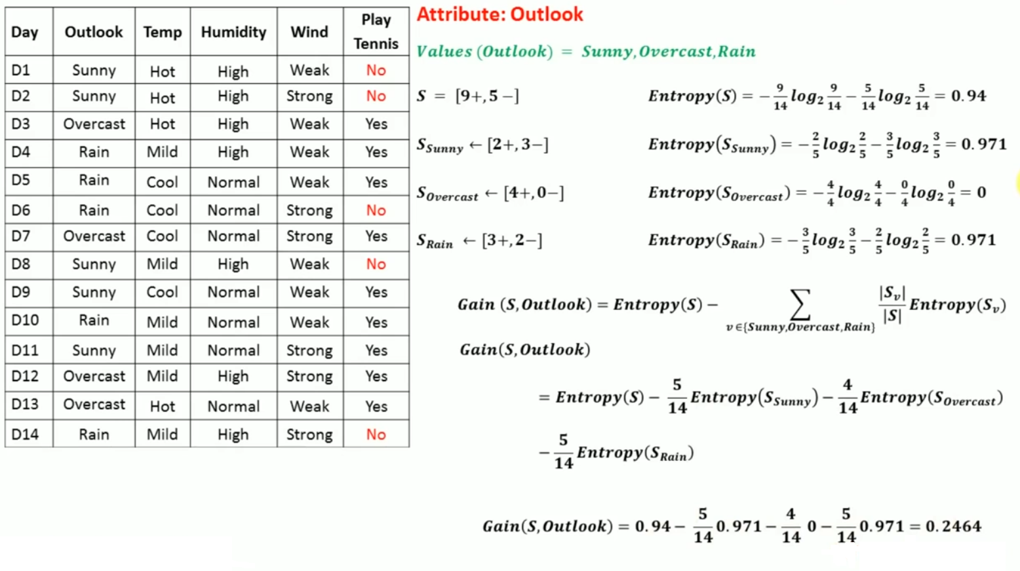

Slide 10
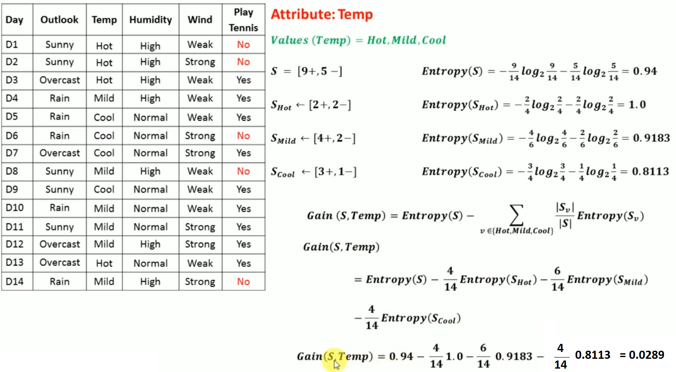

Slide 11
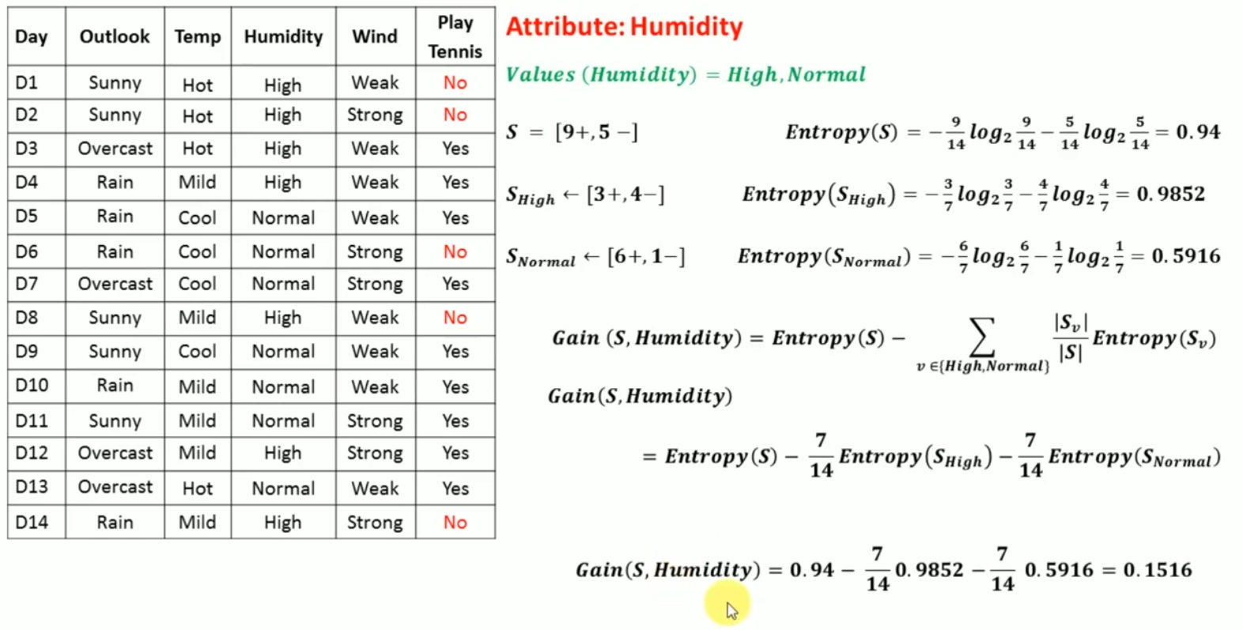

Slide 12
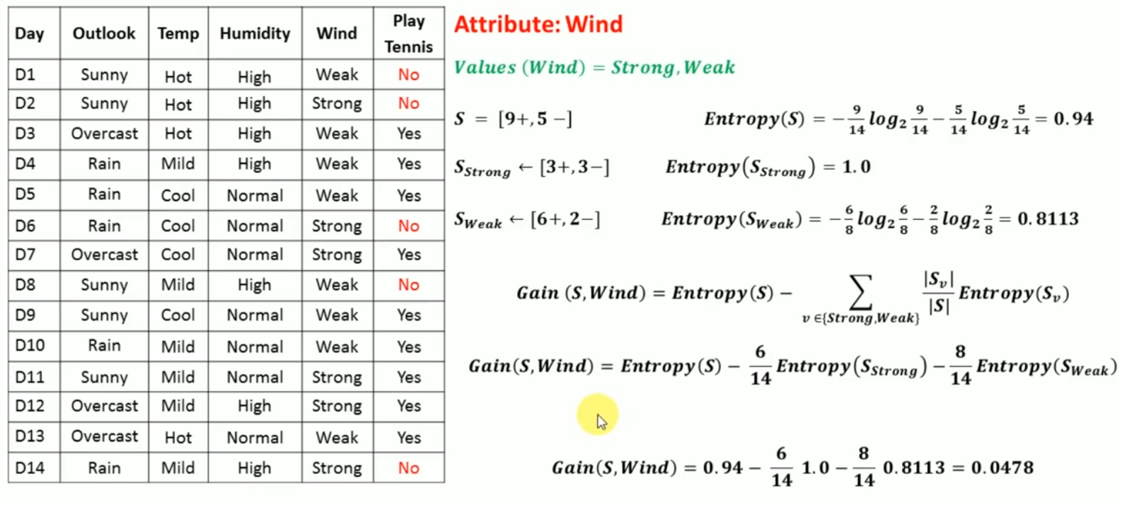

Slide 13
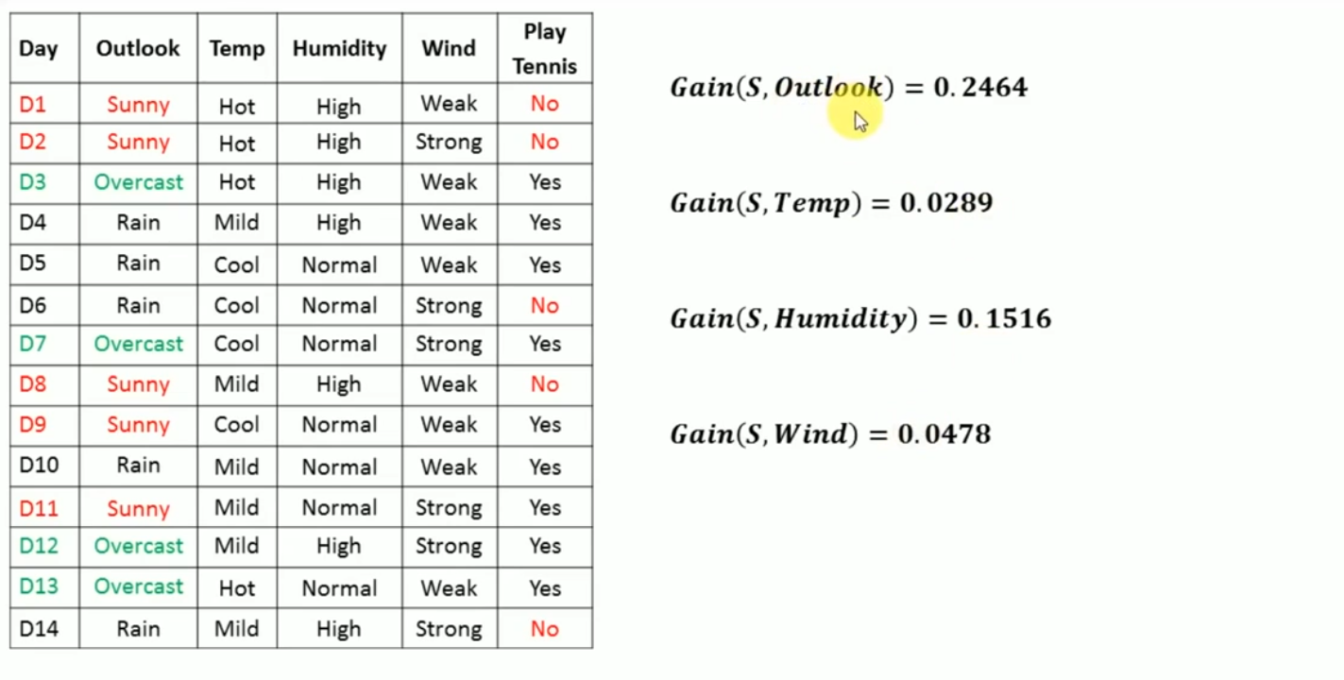
Highest Information Gain

Slide 14
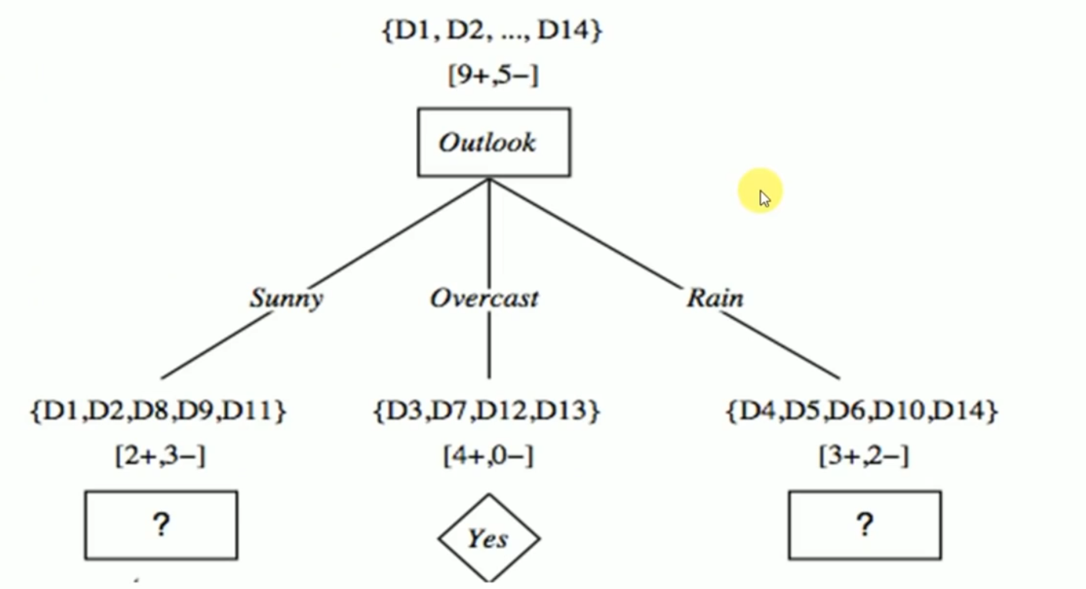

Slide 15
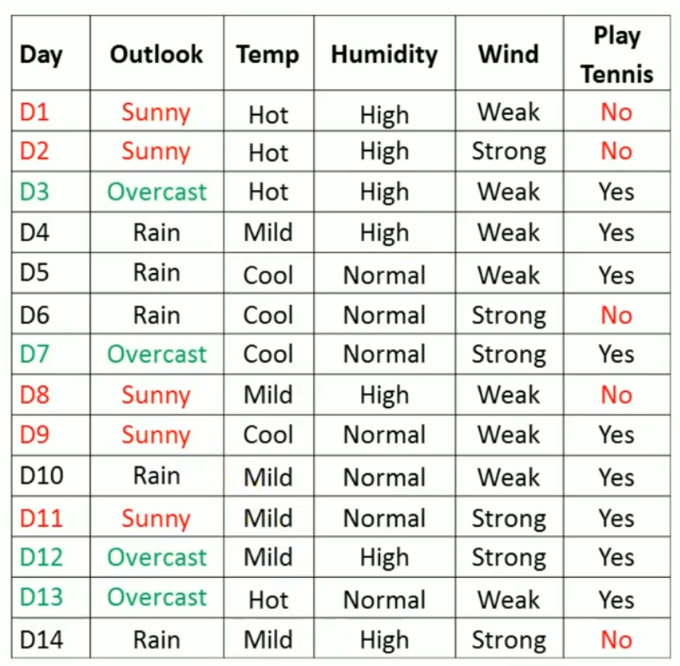
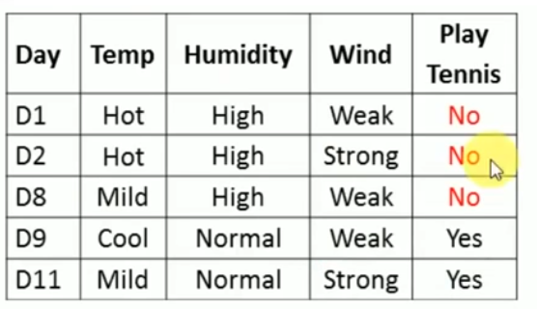

Slide 16
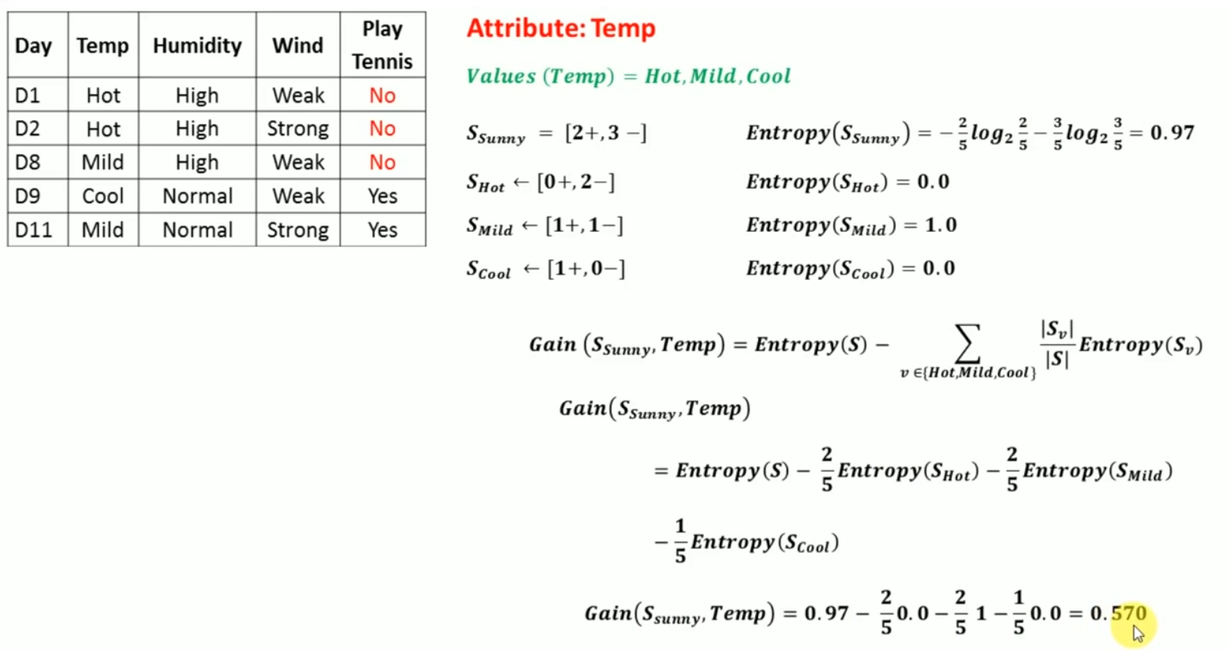

Slide 17
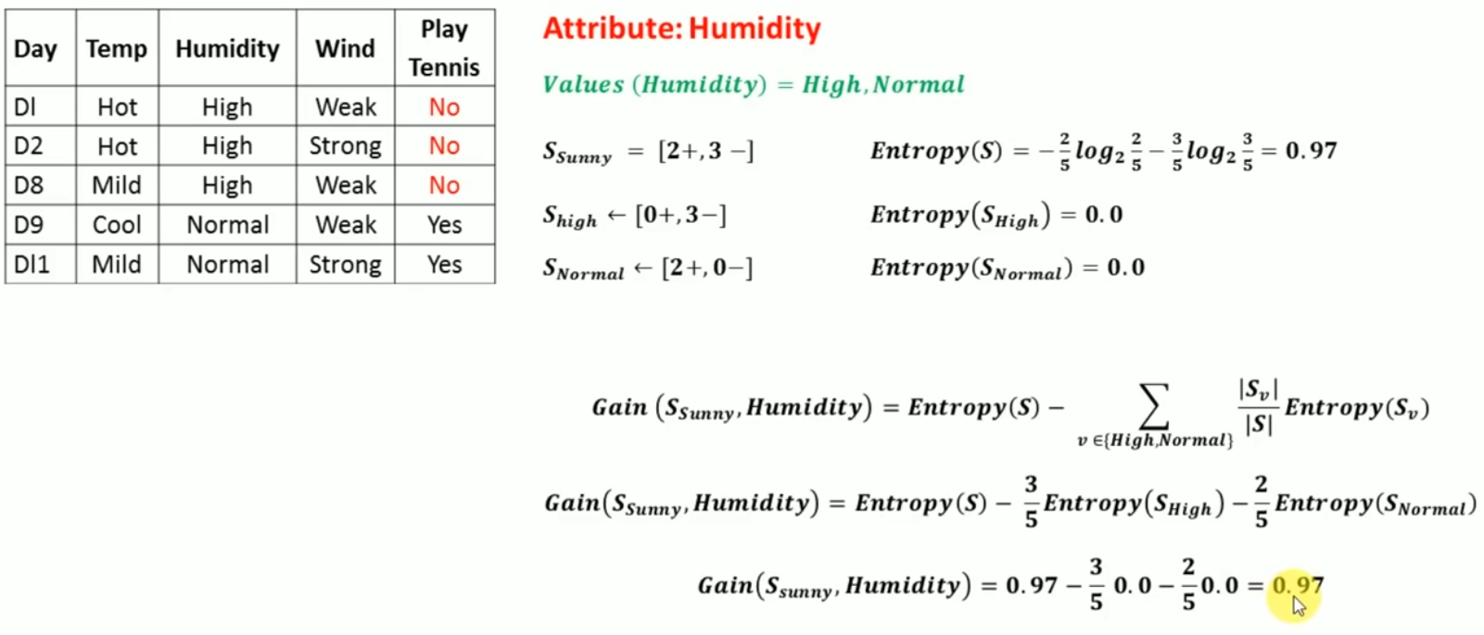

Slide 18
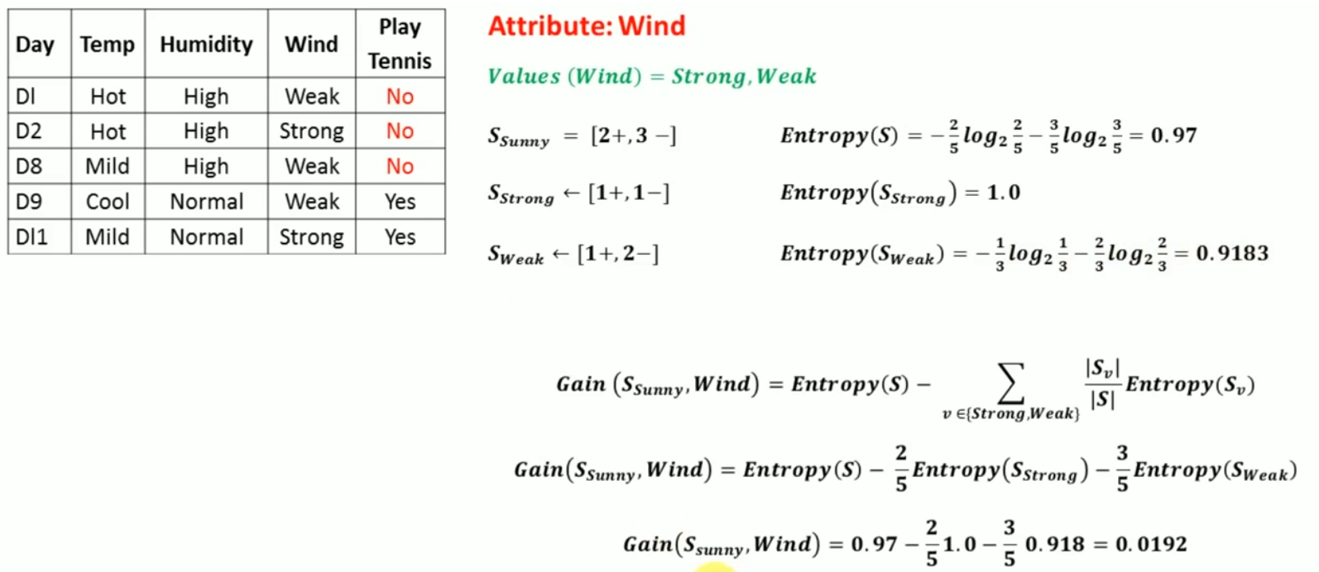

Slide 19
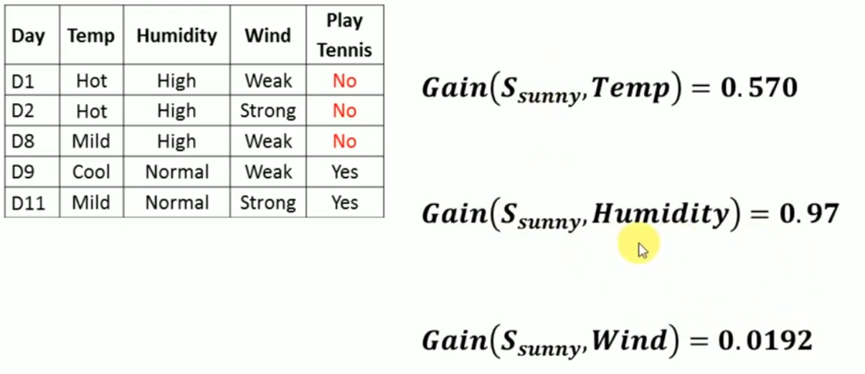

Slide 20
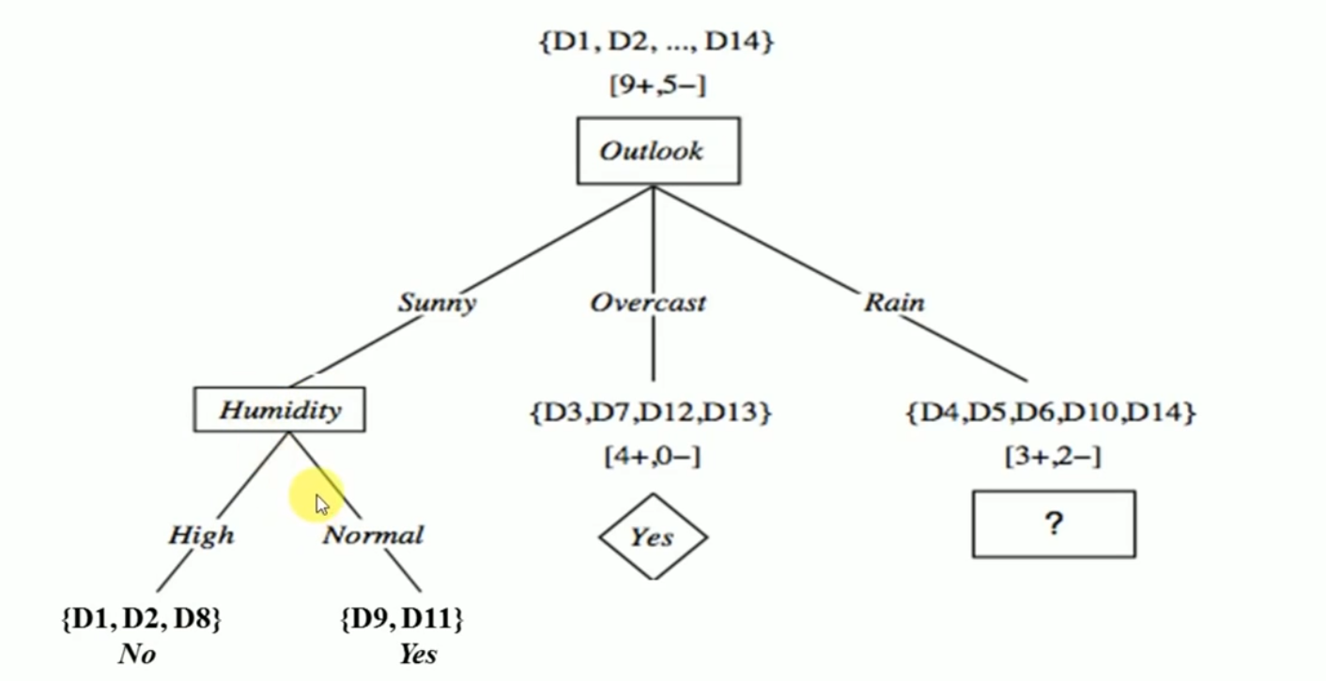

Slide 21
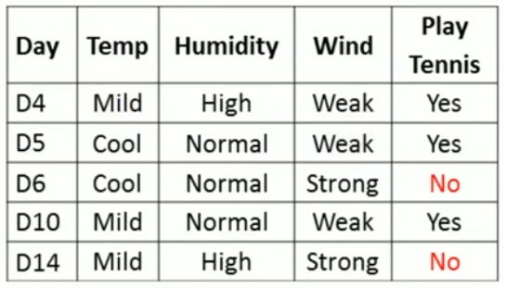

Slide 22
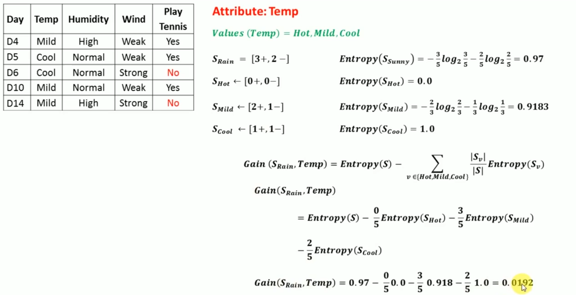

Slide 23
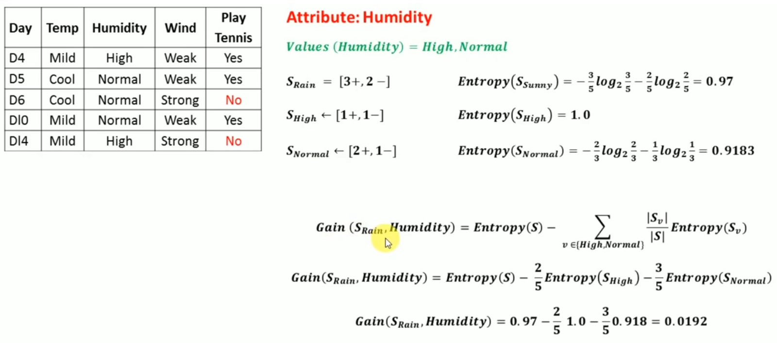

Slide 24
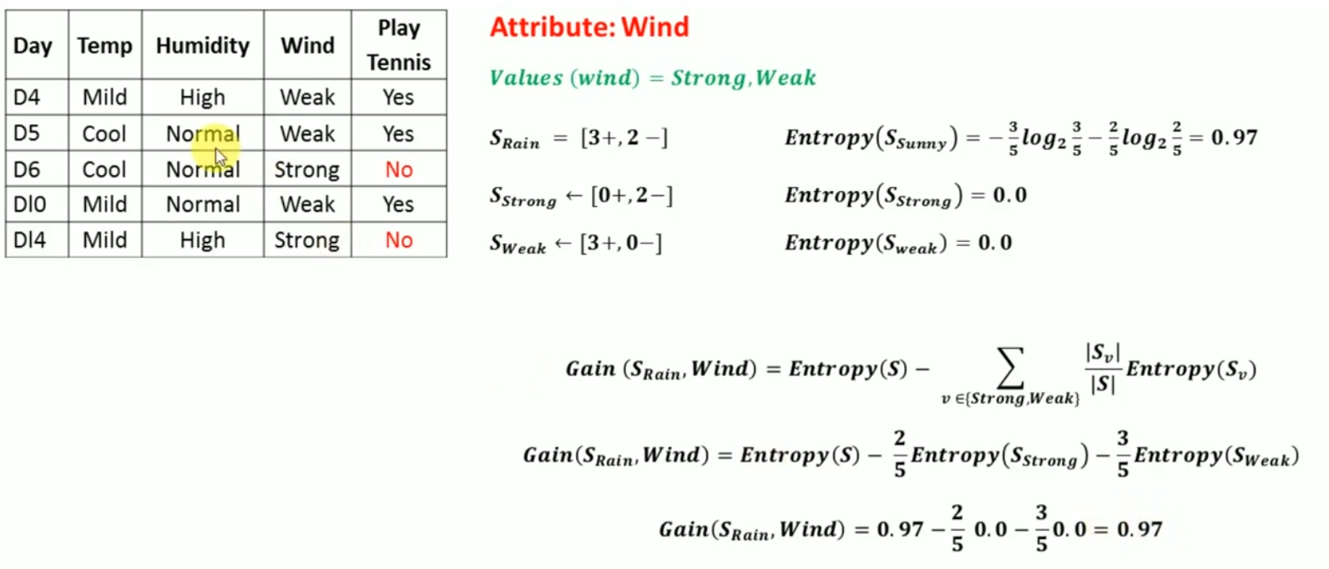

Slide 25
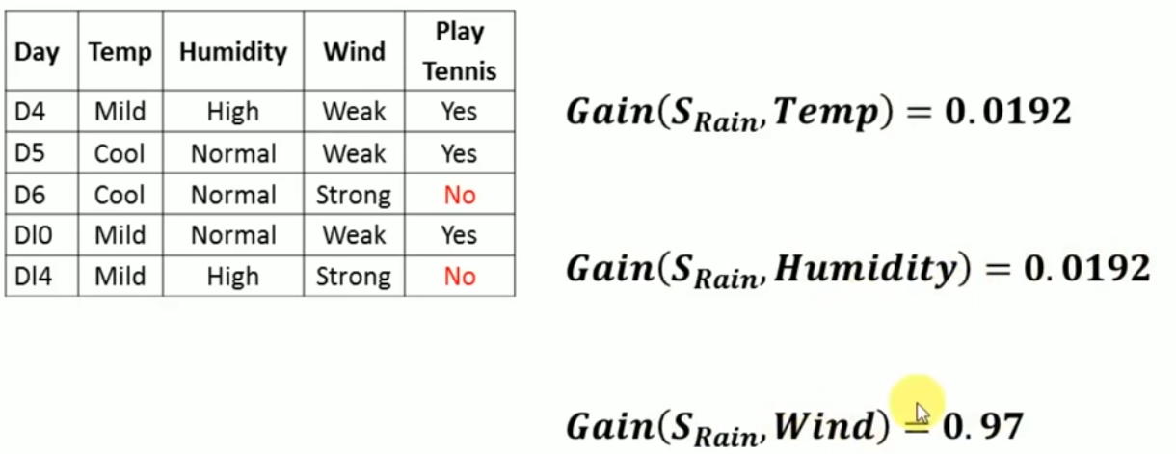

Slide 26
